Slide 1

Fighting Financial Crime:
How Kinectify uses Azure Cosmos DB, Fabric, and Azure AI to stop money laundering in the gaming industry

Slide 2
What Kinectify is
Transforming the Gaming Industry with leading edge technology to combat money laundering
Bringing Efficiency through technology
SaaS, Cloud Only solution

Slide 3
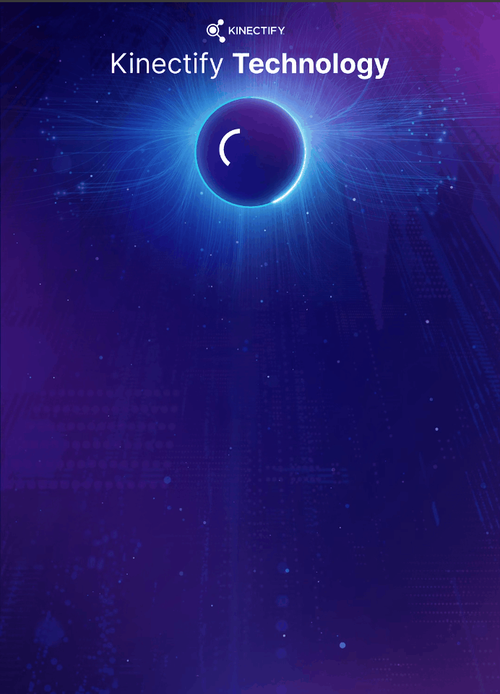
Platform Architecture

Slide 4
Why we chose Azure Cosmos DB
Infinite scalability
Single-digit Millisecond latency
Multi-master writing and geo-replication
Developer Productivity

Slide 5
Developer Productivity
Simplicity is the ultimate sophistication – Leonardo da Vinci
Schemaless
Application level versioning strategy
Maximum flexibility
Simplified deployments
Excellent SDKs
Well documented
Consistent with other Azure libraries
Powerful Queryability
Excellent LINQ support
Batch Execution for performance
Aggregates, Functions, and Projections optimize queries
Generic Repository
Reduces Azure Cosmos DB learning curve
Ensures consistent use of best practices
Covers 85% of usage scenarios
Highly extensible

Slide 6
Generic Repository Library
Created 6 years ago, actively developed
Open-source, MIT Licensed
GitHub Link – https://github.com/sddev-dotnet/azure-cosmosdb-generic-repository/tree/master/SDDev.Net.GenericRepository
Follows Decorator Pattern for Extensibility
Supports Azure Search Indexing, Distributed Caching, Bulk operations, etc.

Slide 7
Demo

Slide 8
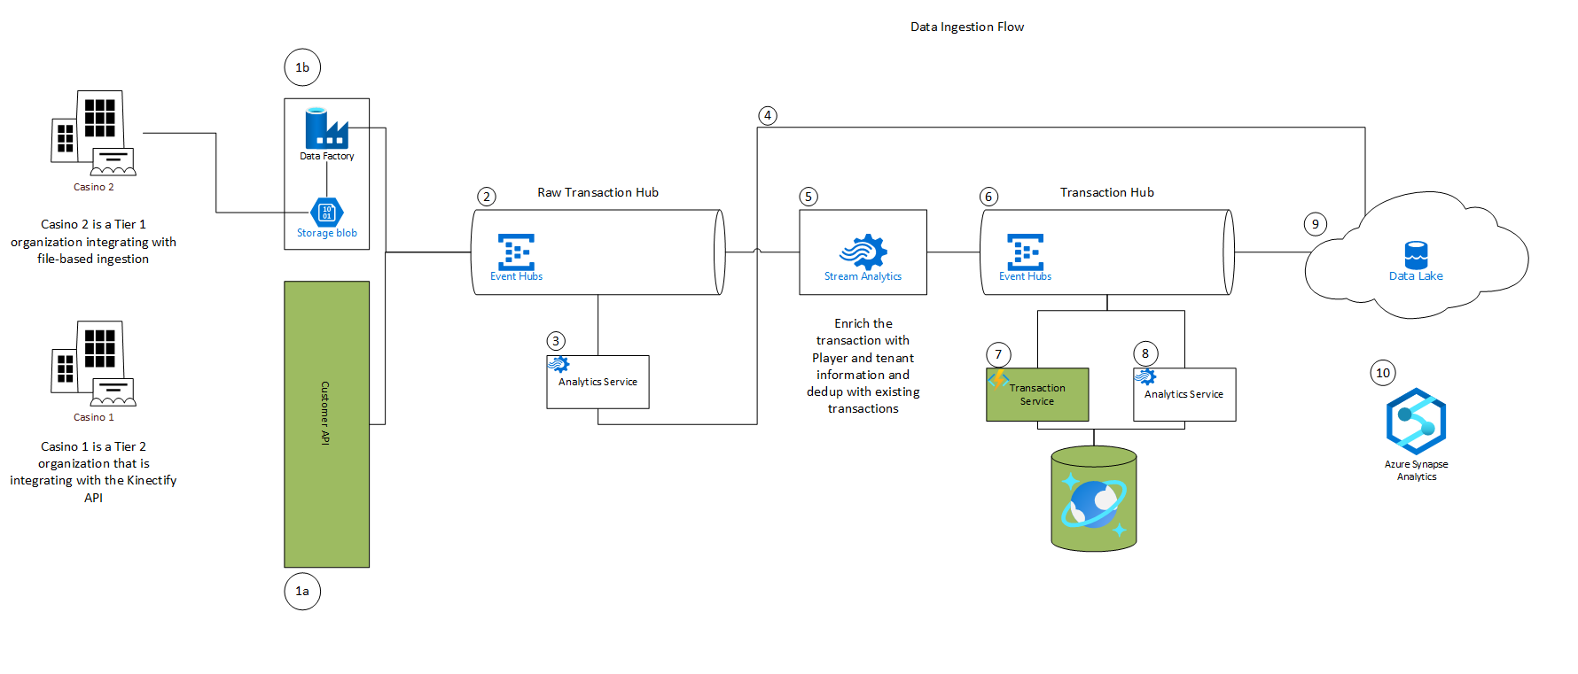
Pipeline for Massive Data Ingestion

Slide 9

AI at Kinectify
LLM/NLP
Gov. Filing Generation
Investigation Summarization
Traditional AI/ML
Alert Detection
Anomaly Detection
Behavior Evaluation
Clustering/Relationships

Slide 10


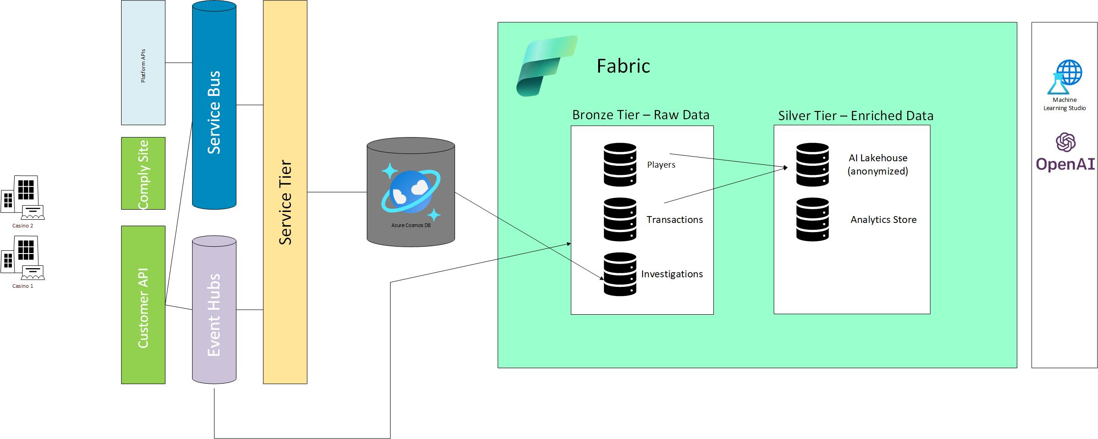
AI/ML Ops Pipeline

Slide 11
Lessons Learned - Denormalization
Structure your data for querying
Embed
Hybrid Embed
Separate
Collections are not tables and shouldn’t be treated like them
TypeNameHandling is awesome in C#, not awesome elsewhere

Slide 12
Lessons Learned - Partitioning
Surrogate Keys
Plan your partitions for querying

